Slide 1

AOI AI
Jan 2023

Slide 2
Background / Objectives:
Background / Problem:
The AOI false-call with manual judgment operation which bring us inconsistent test result and low productivity(current AOI H/C 28).
Process Affected:
AI judges the result of the False Call of the AOI machine and stores the result in the database. The client clicks Good or NG on the interface to obtain the result from the database.
Objective:
AOI process improvement though AI solution to reduce the 12 DL H/C (Target: BU6- 3 lines AOI DL H/C & Cisco- 3 lines DL H/C; total of 12 DL H/C for 2 shifts).
Stake Holder: ME

Slide 3
Team Members
No | Name | Job Title | Functional Department | Email
1 | CL Yeoh | Site Test Engineering & Innovation Leader | TE | cl.yeoh@flex.com
2 | Sam Wong | Site ME leader | ME | Sam.Wong@flex.com
3 | Seng Heng Eeow | Technical Ops Leader | TE | sh.eeow@flex.com
4 | Dean Zheng | Sr. Equipment Engineer | ME | dean.zheng@flex.com
5 | Rachel Li | Sr. Software Development Engineer | TE | rachel.li2@flex.com
6
7
8

Slide 4
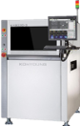


AOI management procedure
False - Call
Trained Operator
AOI Machine
Check and click NG / Good
Manual control
Well-experienced Operator
Client
AOI Software Interface

Slide 5




AOI AI management procedure
False - Call
Passer Download IMG
AI Judge IMG Result and Save in DB
KY Time Delay :10 s
ViTrox : 0 s
AI Program
Time Delay : 0 s
DB
AOI Machine
Passer
Pass the AI Result From DB
Auto click NG / Good Base on AI Result in the interface
No Operator Control
Duplicate on different lines
KY Total time delay 16 s
ViTrox 0 s
Client
AOI Software Interface
Client Program
Time Delay : 6 s

Slide 6
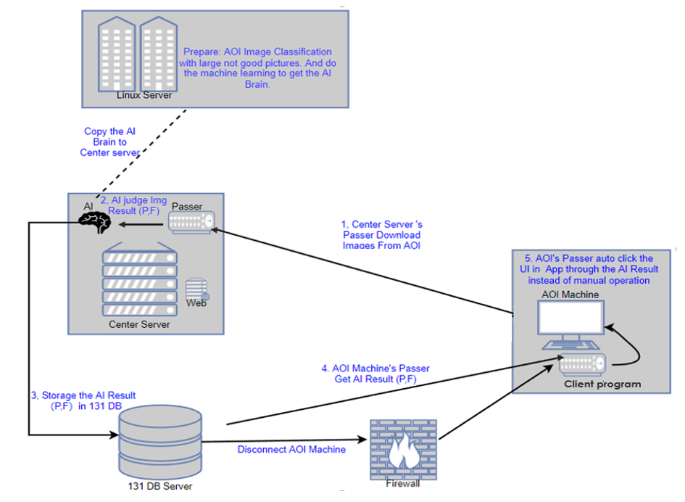
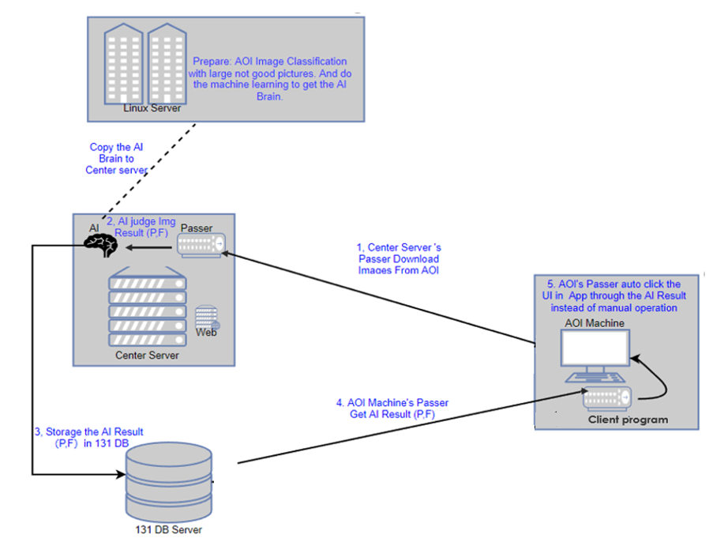








Topological Diagram

Slide 7
Machine Learning Training Process
Data Collect
Data preprocessing
Feature Extraction
Model Selection and Training
Model Evaluation
Optimize and Deploy

Slide 8
Start
Dimensionless
Missing value calculation
Data Collect
Feature Selection
Model Training
Model Training Details
Data Analysis
Quantify Feature Binarization
Dimension Reduction
Data cleaning
Qualitative Feature Encoder
Training
Data Conversion
Predict
Sampling
Assessment
Feature Extraction
End

Slide 9
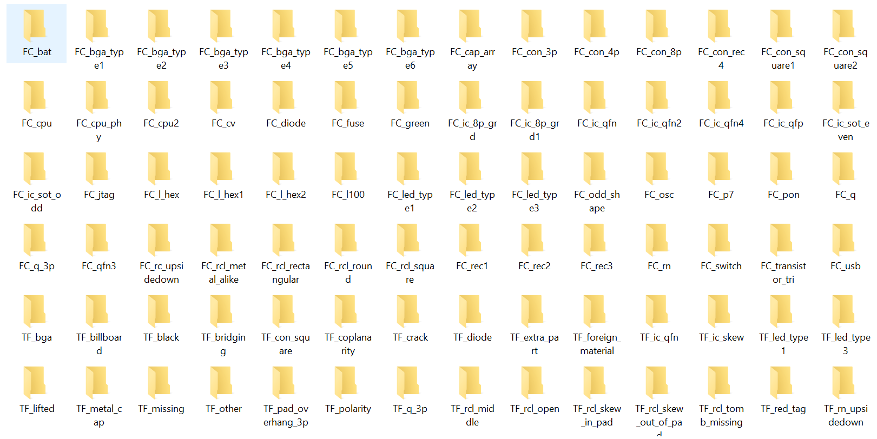
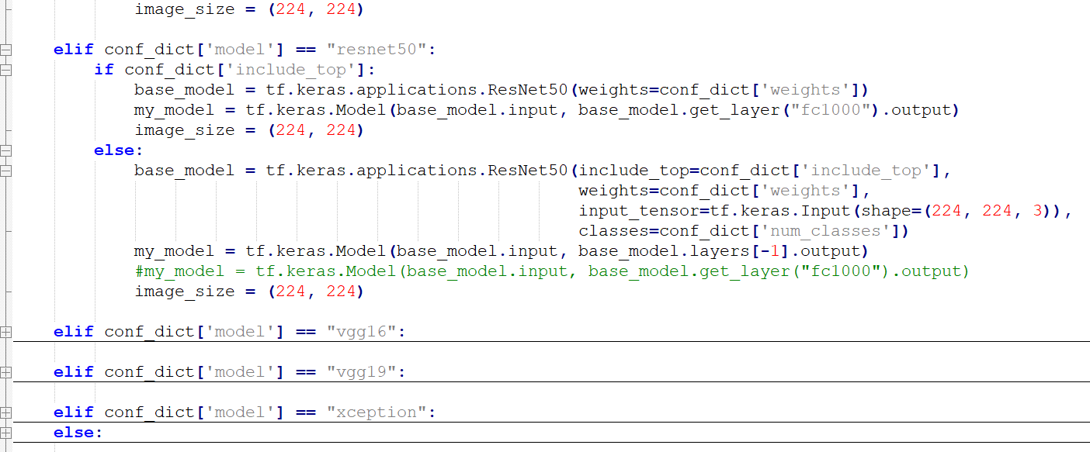
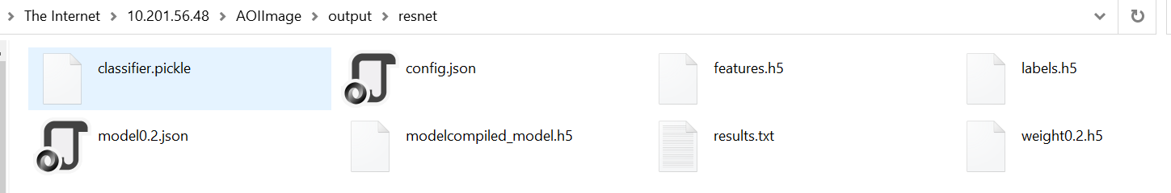
BP Details
Base on the location and material type and image appearance to be separated 93 kinds classification as below,including the false call and true fail.
Classification
Brain Training Code Explanation
define model
Resnet50 Model and Train
Code
Read Images and encode with LabelEncoder
collecting discriminative,generate features and labels
import features and labels, then split them in training and testing with defined split ratio, the test_size
Training Result : Brain
train and evaluate with LogisticRegression model, then plot confusion matrix

Slide 10
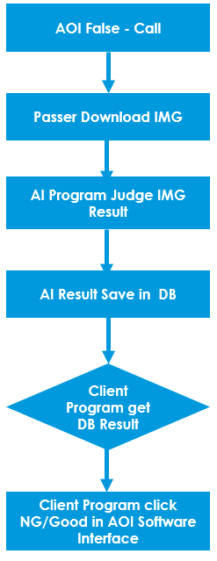
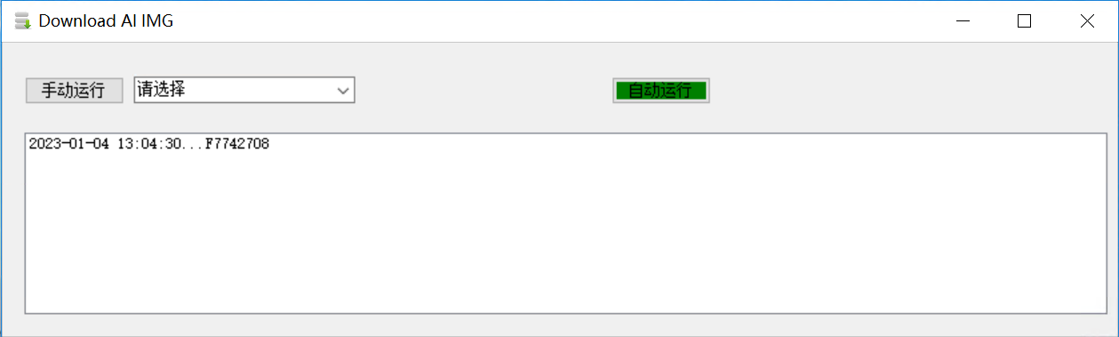
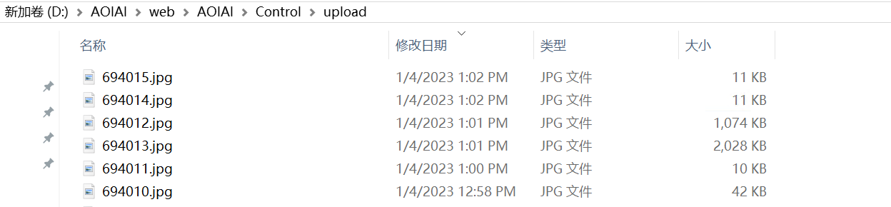
BP Details
The passer monitor the AOI database every 10 seconds. It would download the Image to local folder from the
DB once it check the AOI Machine Fales Call the image.
Passer
Image Folder

Slide 11
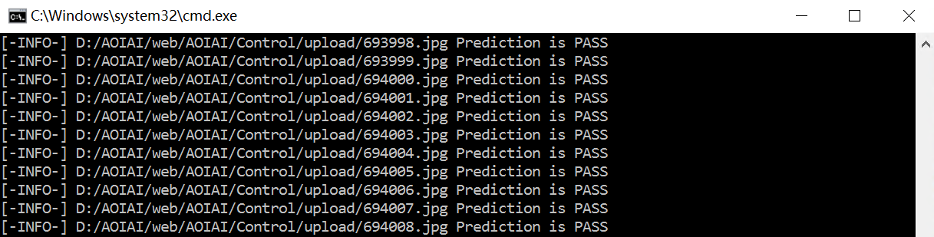
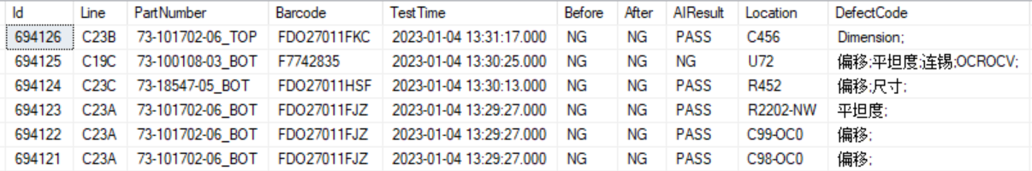
BP Details
The AI program real time monitoring the image folder, if it download new image successfully,
Then the AI program would judge this image is NG or Good Result and Save the Result in local database.
Image Folder
AI Progress
Local Database

Slide 12
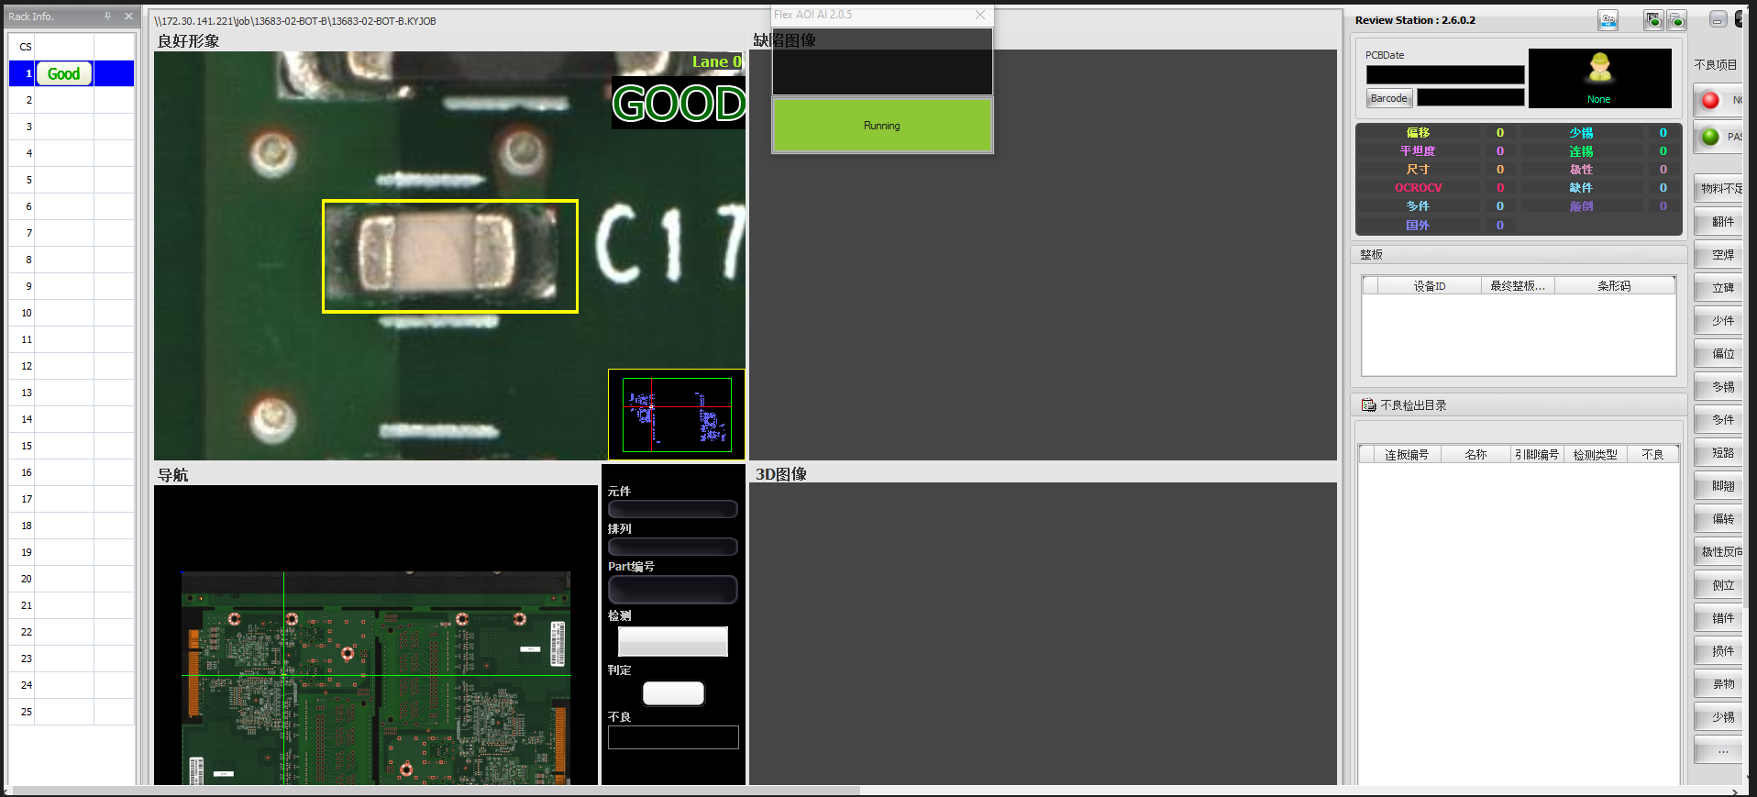
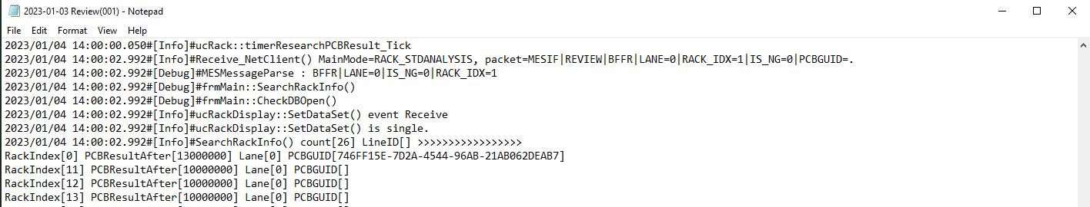
BP Details
The Client program monitor the log, it would get the database’s AI result through the log’s PCBGUID.
The program would auto click NG / Good button on the AOI Software Interface once it get the AI’s result.
Client Program
Log’s GUID Match DB’s GUID

Slide 13
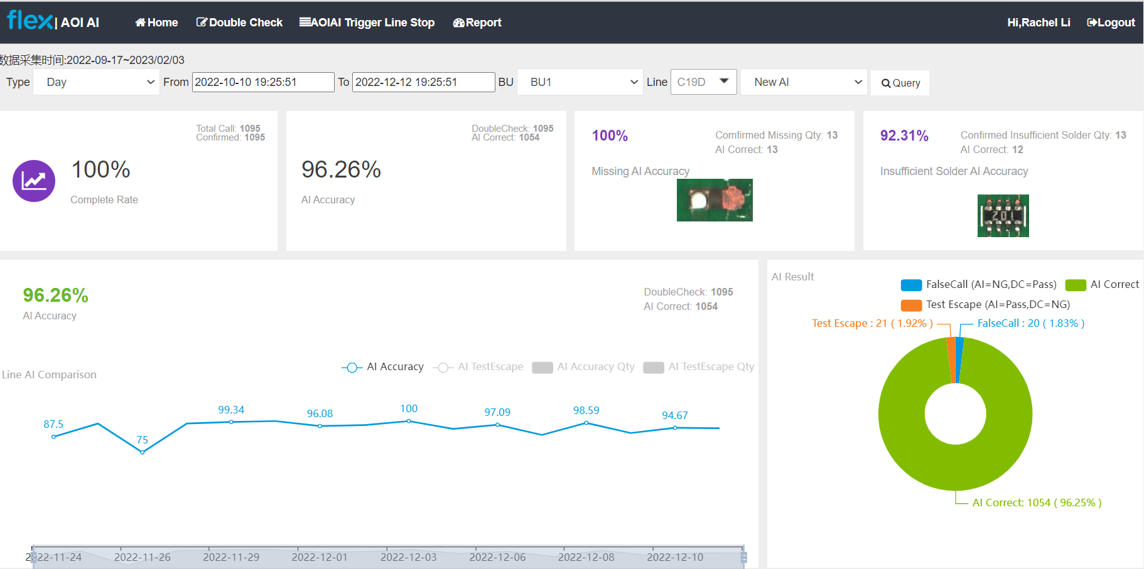
BP Details
Wb site to monitor the AI Accuracy and Test Escape report. And also apply for the location image details info.

Slide 14
Implement KY AOI Automation Detail
Server
AOI False Call
New Record In AOI DB
Passer Collect Data and Image from AOI DB
AI Brain Judge the Image Result and Save Local DB
Next
Maintain
New Record in Log File
Client Program Read Log info and Get AI Result in Local DB
Client Program Auto Click NG/Good
Software Clear the Image
AOI False Call
Next

Slide 15
Implement ViTrox AOI Automation Detail
Server
AOI False Call
New Data and Image in Folder
Passer Collect Data and Image from Folder
AI Brain Judge the Image Result and Save Local DB
Next
Maintain
New Index File in Folder
Client Program Get Local DB’ AI result
Client Program Auto Click NG/Good
Software Clear the Image
AOI False Call
Generate Post File
Next
New Blank Defect Folder

Slide 16
Line AI Accuracy
The data monitor from 2022-09-17 19:24:40 to 2022-12-12 19:24:40.
AI Accuracy 96.26%
AI Accuracy 96.45%
AI Accuracy 96.89%
Total 1095 Qty
Total 2087 Qty
Total 835 Qty
C19D
C23B
C20C
AI Correct 1054
AI Correct 2013
AI Correct 809
Test Escape 21
Test Escape 48
Test Escape 10
AI Accuracy 92.23%
AI Accuracy 94.9%
AI Accuracy 89.27%
Total 103 Qty
Total 9607 Qty
Total 233 Qty
C23C
C19C
C23A
AI Correct 95
AI Correct 9117
AI Correct 208
Test Escape 5
Test Escape 317
Test Escape 12

Slide 17
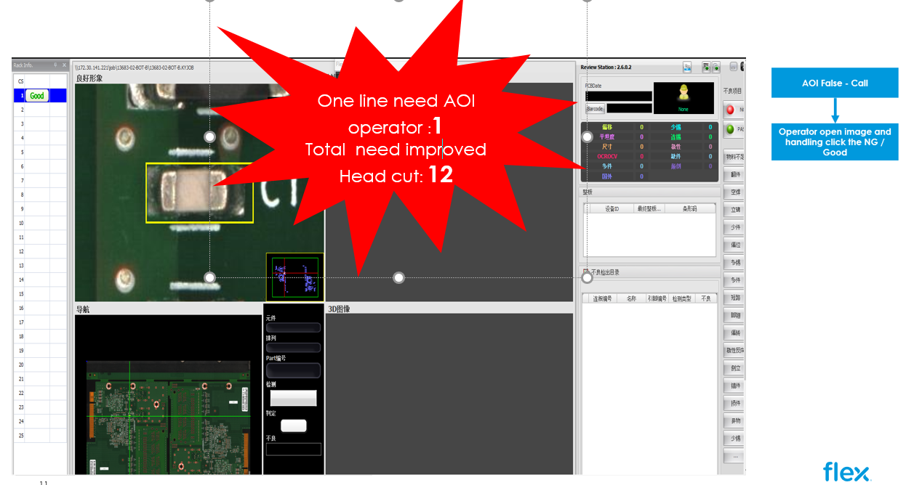
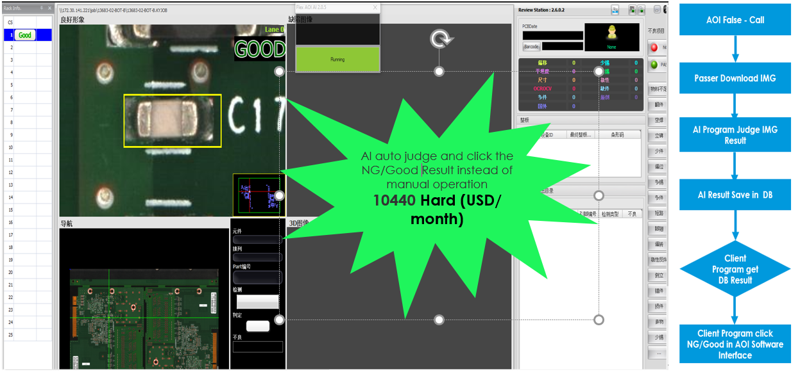
Title : AOI AI
Operations/ Station | Problem | Action Taken | Results
PCBA/SMT | AOI Machine fail the location within the PCB image, the well-experience operator manual open the image and then click the NG / Good result on the software interface one by one. | AOI Machine fails the location image, AI auto check the fail image and judge this image is NG / Good. The Client program auto click the NG / Good button on the AOI Software instead of manual operation. 6 lines is already install the AOI AI program. Total 12 head cut need improve including day shift and night shift. Hard saving : 870*12=10440 | CTQ (UoM/Criteria) | Before | After | % Improved | Savings
 |  |  |  |  |  |  | Hard (USD/ month) | Soft (USD/ month) | Inventory /AR/AP (USD)
 |  |  | AOI AI lead time (Online) reduction (Hr/Model) | 3.65*12 / Hr | 0 | 100 | 10440
Customer
All
Method of Sustaining
Before Kaizen
After Kaizen

Slide 18
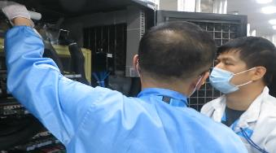
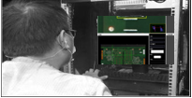
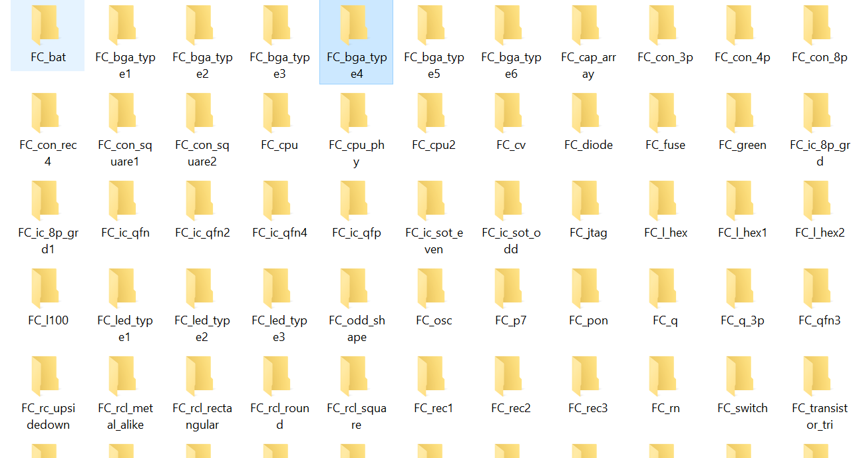
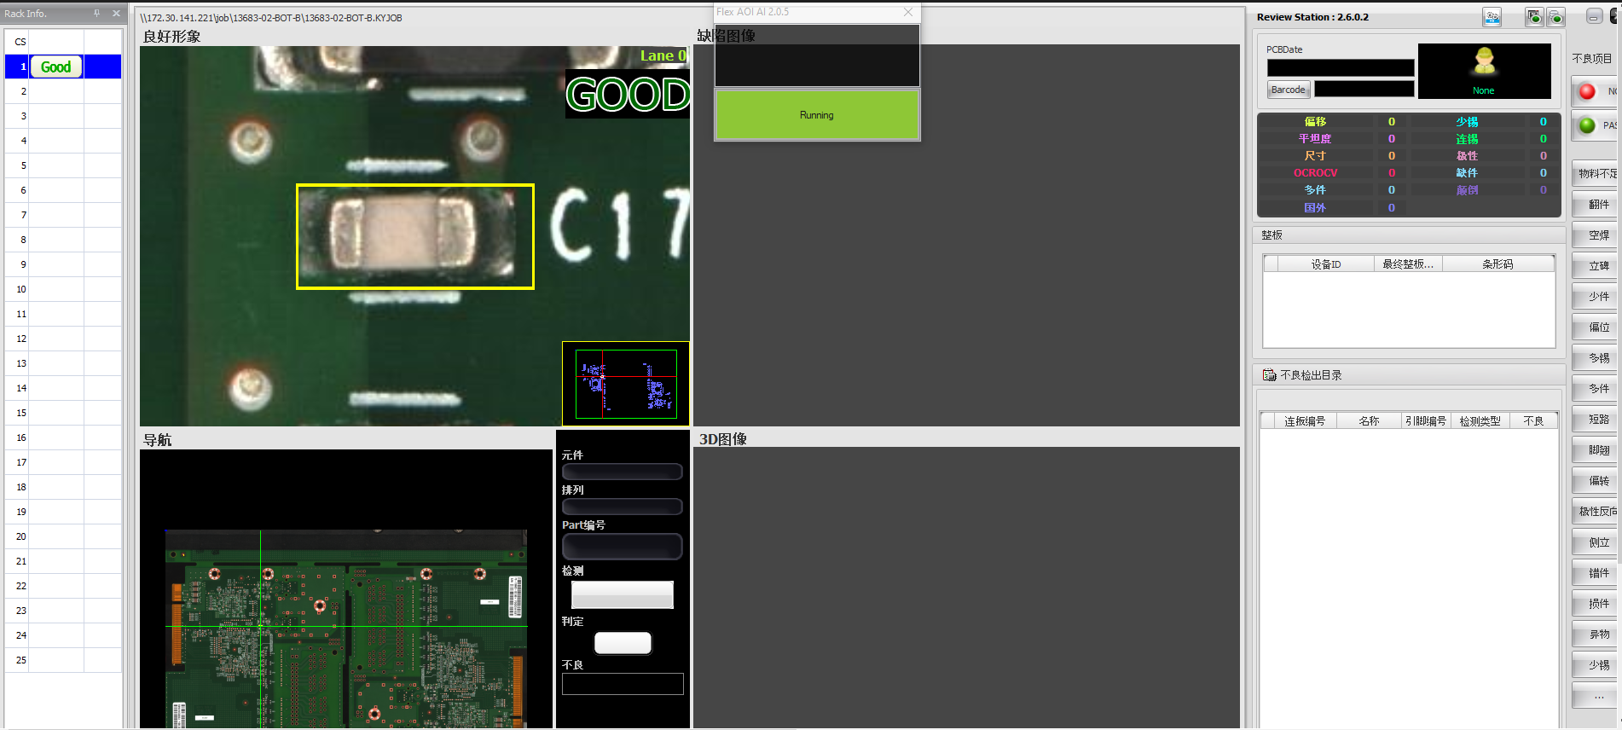

BEFORE
Engineer online training new operator face to face to learn kinds of AOI fail situation.
AOI Machine fail the PCB image and hold on the software interface.
Operator open the image location content one by one confirm and click the NG / Good result.
1
2
3
AOIAI Immersion Technology Application in Factory
AFTER
Client program monitor the log and auto get the database’s location AI result then auto click the NG / Good button on the software interface.
Passer download the AOI fail image and AI auto judge the location image as NG / Good Result and save in database.
Collect and training AI brain by kinds of AOI Image defect Code.
AOI Machine fail the PCB image and hold on the software interface.
4
1
2
3
Introduced AOI AI auto judge the fail image online to replace manual operation, and do the head cut result as target.
RESULT
Headcount
12 People
0 People

Slide 19
Best Practice Implementation Method and Procedure
Tools developed and deploy:
Python – AI Brain Training and judge result
VS – Passer and tool for interface development
AI Framework – TensorFlow
Training Mode – Self-supervised Learning
Model - ResNet50
Algorithm - Logistic Regression

Slide 20
Contact for Yokoten
No | Name | Job Title | Functional Department | Email
1 | Rachel Li | Sr. Software Development Engineer | TE | rachel.li2@flex.com
2 | Dean Zheng | Sr. Equipment Engineer | ME | dean.zheng@flex.com

Slide 21
Q&A
Is the capability of AI algorithm and machine learning the site's own, or is it cooperated with a third party?
It is to directly call third-party open source algorithms and models
Is there an official flex AI software tools to use? Any comparison vs. Flex criteria and benefit, please add 1page comparison
No, this system was developed by B11 Site.
if you use AI to train, can you save the data?
We use our own servers to save image and training, so the data is safe.
Is your AI calculation cater to latest technology? May cross sharing with Suhong - Si Hong team
The automated training step is need refined to improve accuracy; Also,the details have also been shared with them.

Slide 22
Thank You

